Slide 1
NDN-IoT Framework and Example Application “Flow”
Zhehao Wang, Eitan Mendelowitz, Zoe Sandoval, Jeff Burke
Mar 23, 2017

Slide 2
Introduction – NDN-IoT & Flow
NDN-IoT framework
Libraries in JavaScript, Python, C# and C++
Implement naming, trust and bootstrap, discovery and application-level pub/sub functionalities NDN team’s IoTDI '16 invited paper [1]
"Flow" application:
Home IoT game application built using the framework
Cloud-independent, secure (authentication and authorization)
Its design and implementation discussed in NDN teams’ IoTDI ’17 invited paper (to appear)
[1] W. Shang, A. Bannis, T. Liang, Z. Wang, Y. Yu, A. Afanasyev, J. Thompson, J. Burke, B. Zhang, L. Zhang. Named Data Networking of Things (Invited Paper). In IoTDI, 2016

Slide 3
Flow: components
Component | Device | Role
OpenPTrack (opt) | Linux workstation machine | Produces time-series data (location of multiple tracked persons) at 30Hz
Mobile website | Mobile phone | Sends environment control commands and consumes environment status
Virtual camera control | RFduino | Produces NDN data from gyroscope reading. Packetize, and send to helper (RaspberryPi) via bluetooth
Controller/Gateway | RaspberryPi2 | Serves as the trust anchor (runs NDN-pi controller)
Unity3D game engine | OSX machine | Consumes opt, phones, and Arduino data; and renders the virtual environment
Notes:
Flow is a home IoT game application built on top of NDN-IoT framework. A player
Interacts with the game by walking around in an area tracked by OpenPTrack (opt)
Sees his physical tracks affect the terrain in a virtual space rendered by Unity3D game engine
Can also drop images to the virtual space using a mobile webpage
Can control the angles the virtual cameras are facing by rotating gyroscopes

Slide 4
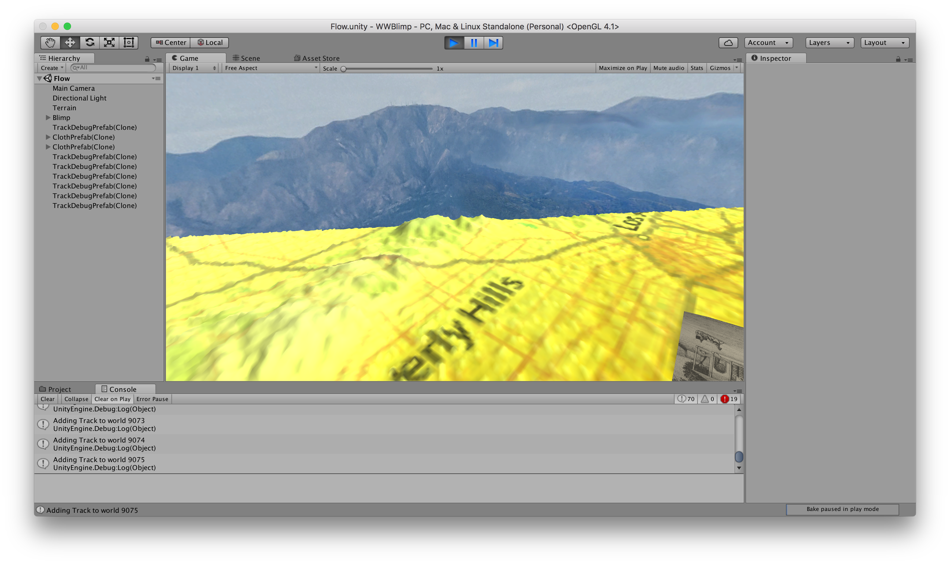
Flow: app message exchanges
Please refer to next page for diagram key

Slide 5
Flow: app message exchange keys

Slide 6
Links and documentation
Code repository
NDN-IoT framework
Functionality overview
Interface description
Flow application
Technical guide (installation and troubleshooting)
Demo poster
Application screen recording

